Slide 1
Academix
Learning Management System (LMS)

Slide 2
Team Members:
Abdelrahman Saad
Moataz Mohammed
Mohamed Sherif
Ashraf Medhat
Mazen Mostafa

Slide 3
Problem Statement:
Universities often rely on multiple disconnected systems to manage students, courses, and communication.
There is no centralized platform that unifies SIS and LMS operations in one structured ecosystem.
As a result, institutions face slow workflows and manual errors.

Slide 4
Why This Project?
Our goal is to create a system that brings the entire university lifecycle into a single, organized platform—from SIS operations to complete LMS functionality.
This project is intentionally scalable and extensible, ready for future modules like AI quiz generation, smart anti-cheat quiz system, automated schedulers, reporting dashboards.

Slide 5
Functional Requirements:
1. User Authentication & Authorization
  Secure login for students, instructors, and admins
  Role-based access control
  User profile management
2. Course Management
  Create, update, and delete courses
  Assign instructors to courses
  Organize lectures and learning materials
  Track course enrollment
3. Lesson & Content Management
  Upload files, videos, links, and learning assets
  Students can view and access all course materials

Slide 6
Functional Requirements:
3. Quiz & Assessment Management
  Instructors create quizzes with multiple question types
  Students attempt quizzes
  Automatic grading for objective questions
  Instructors can override and modify grades
4. Enrollment & Academic Term Management
  Admin manages academic terms
  Students are enrolled into courses by admin
  Prevent duplicate enrollment
5. Grading & Reporting
  GradeBook automatically created for each course
  Grades stored and calculated per student
  Admin and instructors can access reports and analytics
6. Notifications & Announcements
  Send announcements to students
  Notify users of grades, updates, and new materials
  Mark notifications as read

Slide 7
Non-Functional Requirements:
1. Scalability
  Architecture designed to grow with additional modules (AI, scheduling, anti-cheat)
  Database structured for future expansion
2. Security
  Password hashing and secure authentication
  Enforced role-based permissions
3. Usability
  Clean UI with consistent navigation
  Mobile-responsive interface
  Accessible for all user roles
4. Maintainability
  MVC architecture for clean separation of concerns
  Modular database with stored procedures, triggers, and views
  Easy to update and extend

Slide 8
System Roles:
Admin
  User management
  Course + term management
  Create/manage courses
  System control
  Reports
Instructor
  Upload lectures/materials
  Create quizzes
  Announcements
Student
  View enrolled courses
  Access learning content
  Take quizzes
  View grades
  Receive notifications

Slide 9
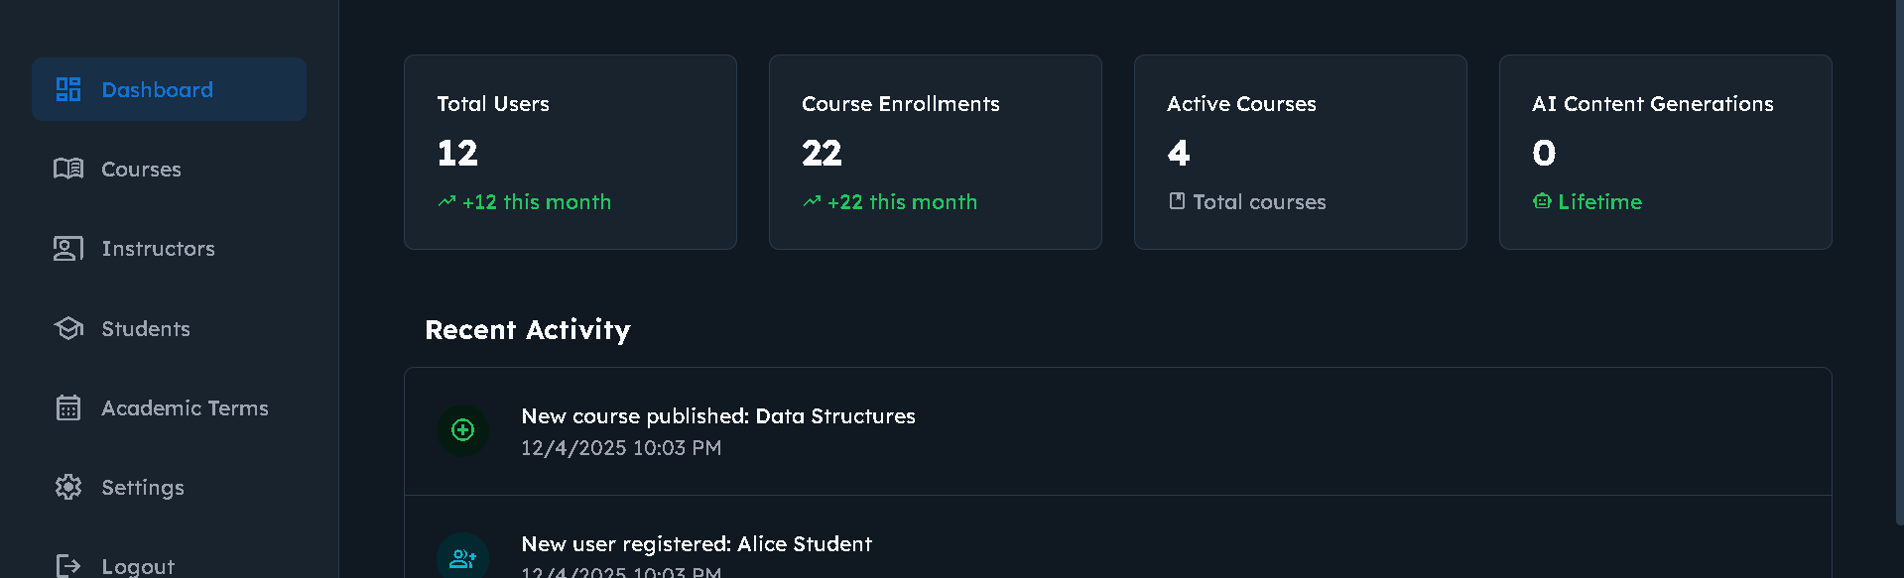
The Admin is the primary administrator responsible for managing and operating the Learning Management System (LMS). They have full authority to control all system elements, including managing users (students and instructors), creating and modifying courses, managing academic terms, monitoring course registrations. The Admin can also add and delete accounts, activate and deactivate users, and ensure the smooth and effective operation of the learning process within the platform.

Slide 10
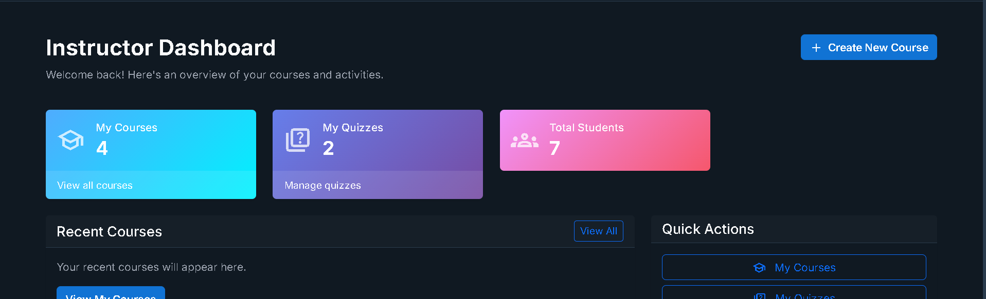
The instructor is responsible for creating and managing educational content within the learning management system (LMS). They have the authority to create courses and lectures, add learning materials (files, videos, links), design tests with various question types (multiple choice, true/false, short answer), monitor student performance through grades and statistics, manage student enrollment lists, and send announcements to students. The instructor can also edit and delete educational content, ensuring an effective and organized learning experience.

Slide 11
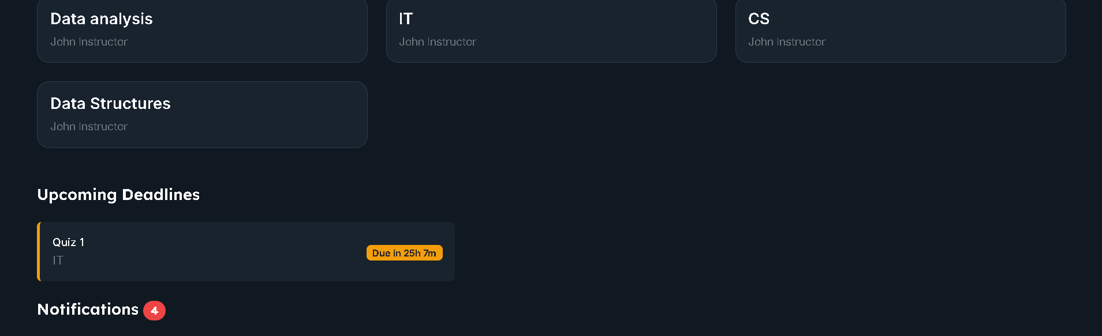
The student is the primary user who interacts with the learning content within the learning management system. They have the privilege of accessing lectures and learning materials, taking various types of tests, viewing grades and results, tracking their academic progress, and receiving notifications and announcements from instructors. Students can also view their profile, update their information, change their password, and monitor test deadlines, thus providing an interactive and organized learning experience.

Slide 12
Tools:
Frontend
  HTML
  CSS
  JavaScript
  Bootstrap
Backend
  ASP.NET MVC
  C#
Database
  Microsoft SQL Server
Other
  GitHub (Version control)

Slide 13
Future Work:
1. AI Integration (planned)
  (Not included in MVP)
  AI quiz generator
  AI course assistant
  Scheduler Generator
2. Assignment System
  Upload PDFs
  Grading workflow
  Feedback delivery
3. Real-Time Notification System

Slide 14
Thank You

